Slide 1


Membership
Renewal + Payment
Presentation - 2024

Slide 2
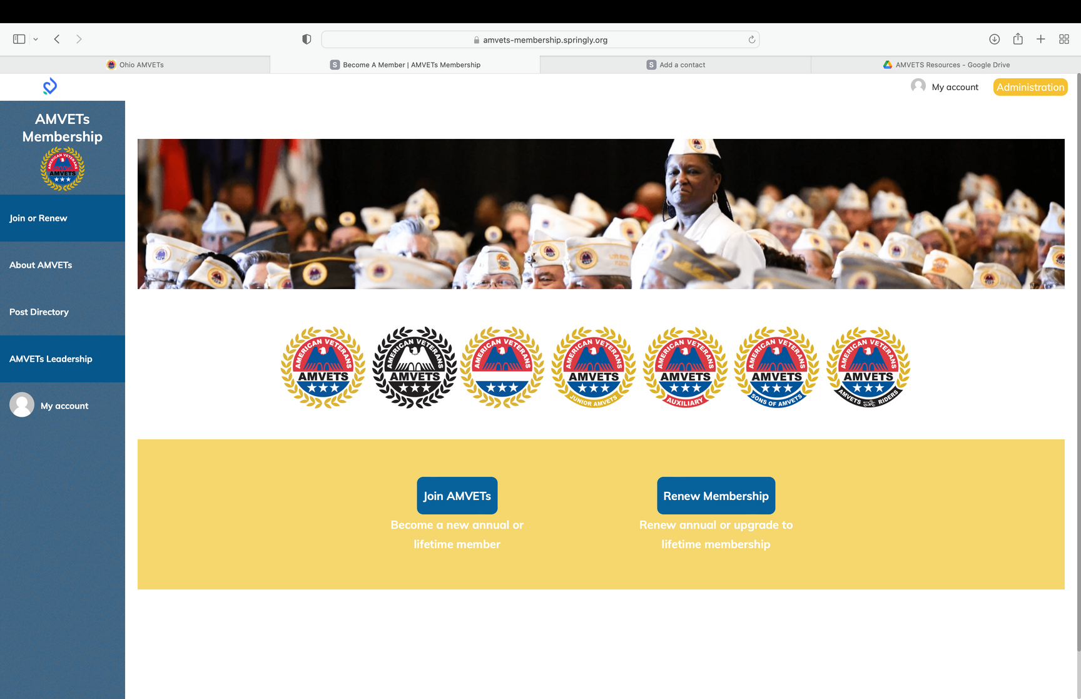

STEP 1
Go to amvets-membership.springly.org, login to your account, then click on “AMVETS Leadership”

Slide 3
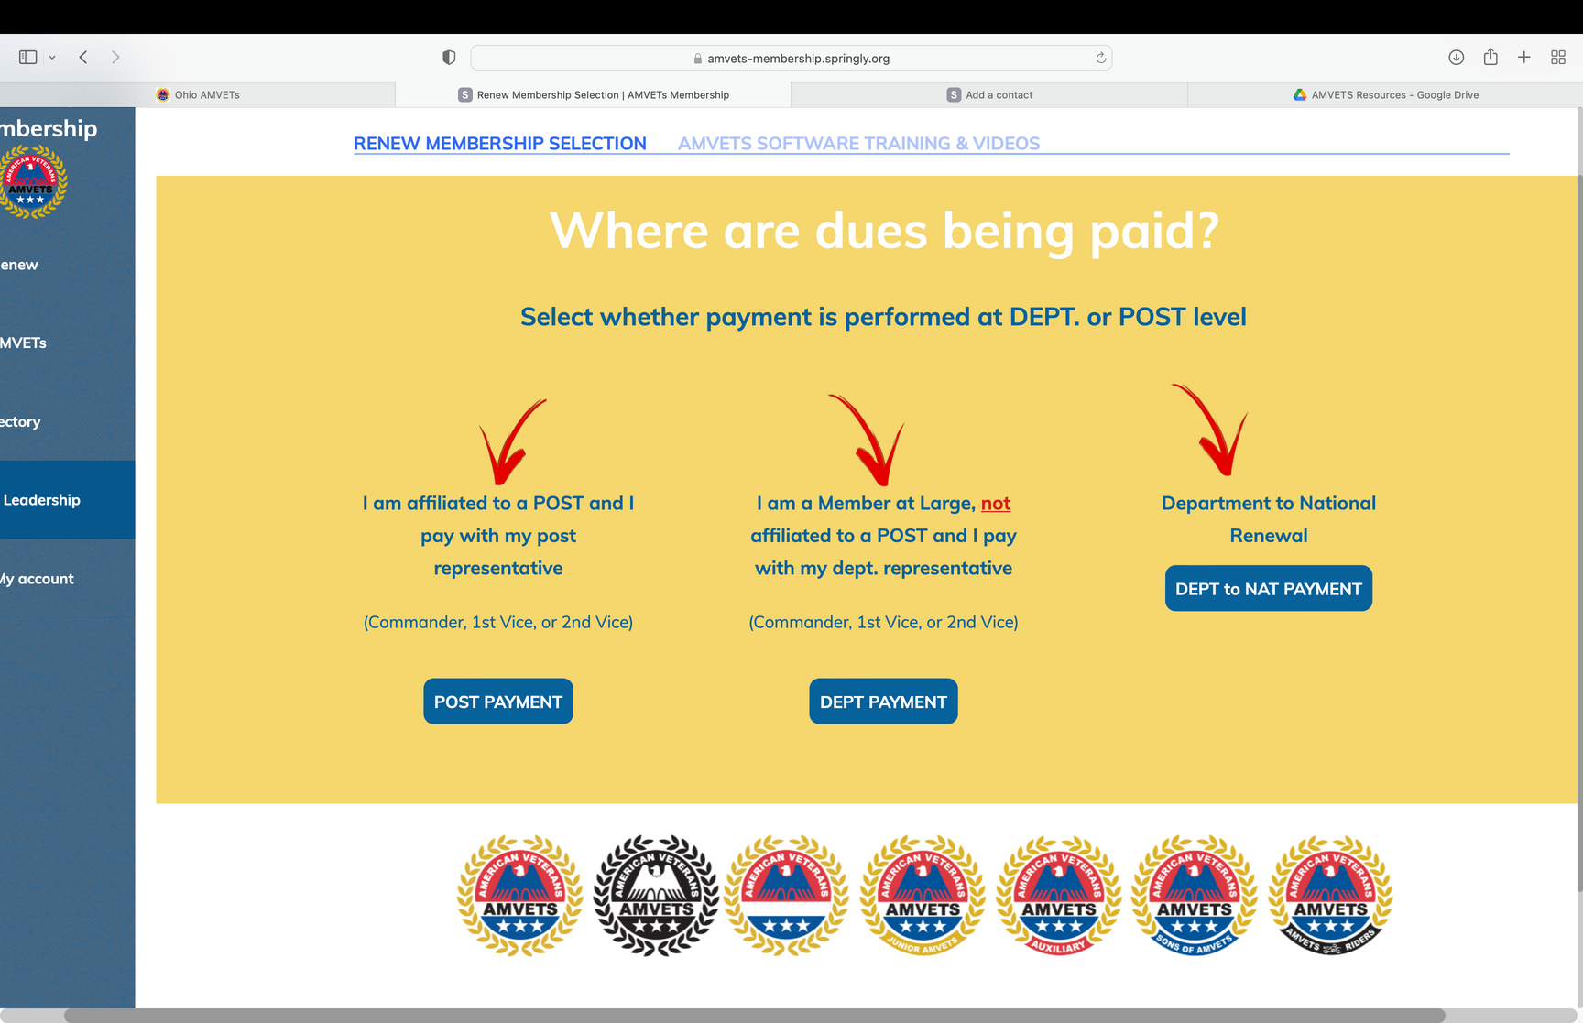
STEP 2
Click “POST PAYMENT”

Slide 4
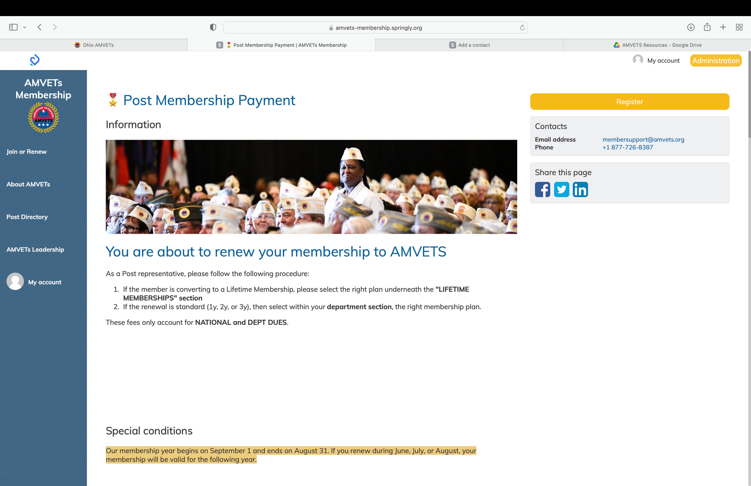
STEP 3
Click “register” on top right

Slide 5
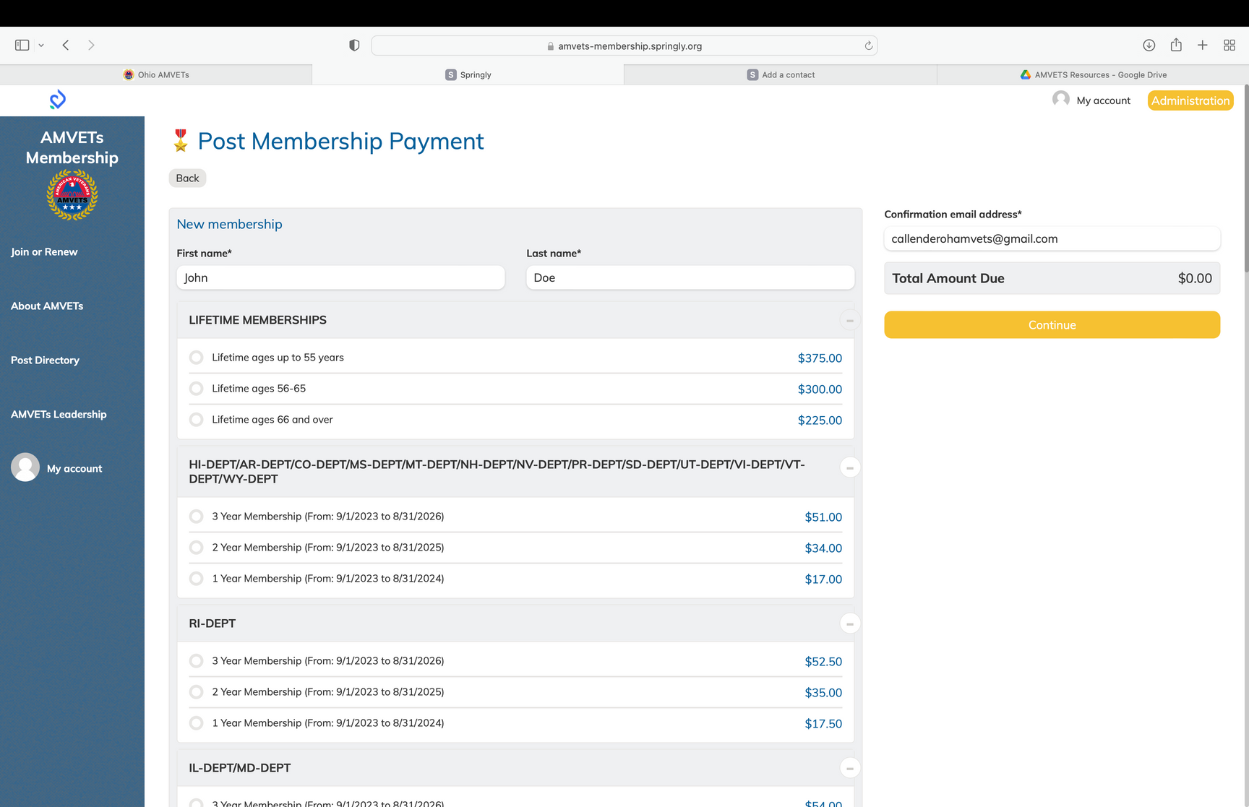
STEP 4
If you are logged into your own account, your name will automatically appear. If you are renewing for another member simply replace your name with theirs.

Slide 6
STEP 5
If you are paying for a life membership select an option based on the appropriate age

Slide 7
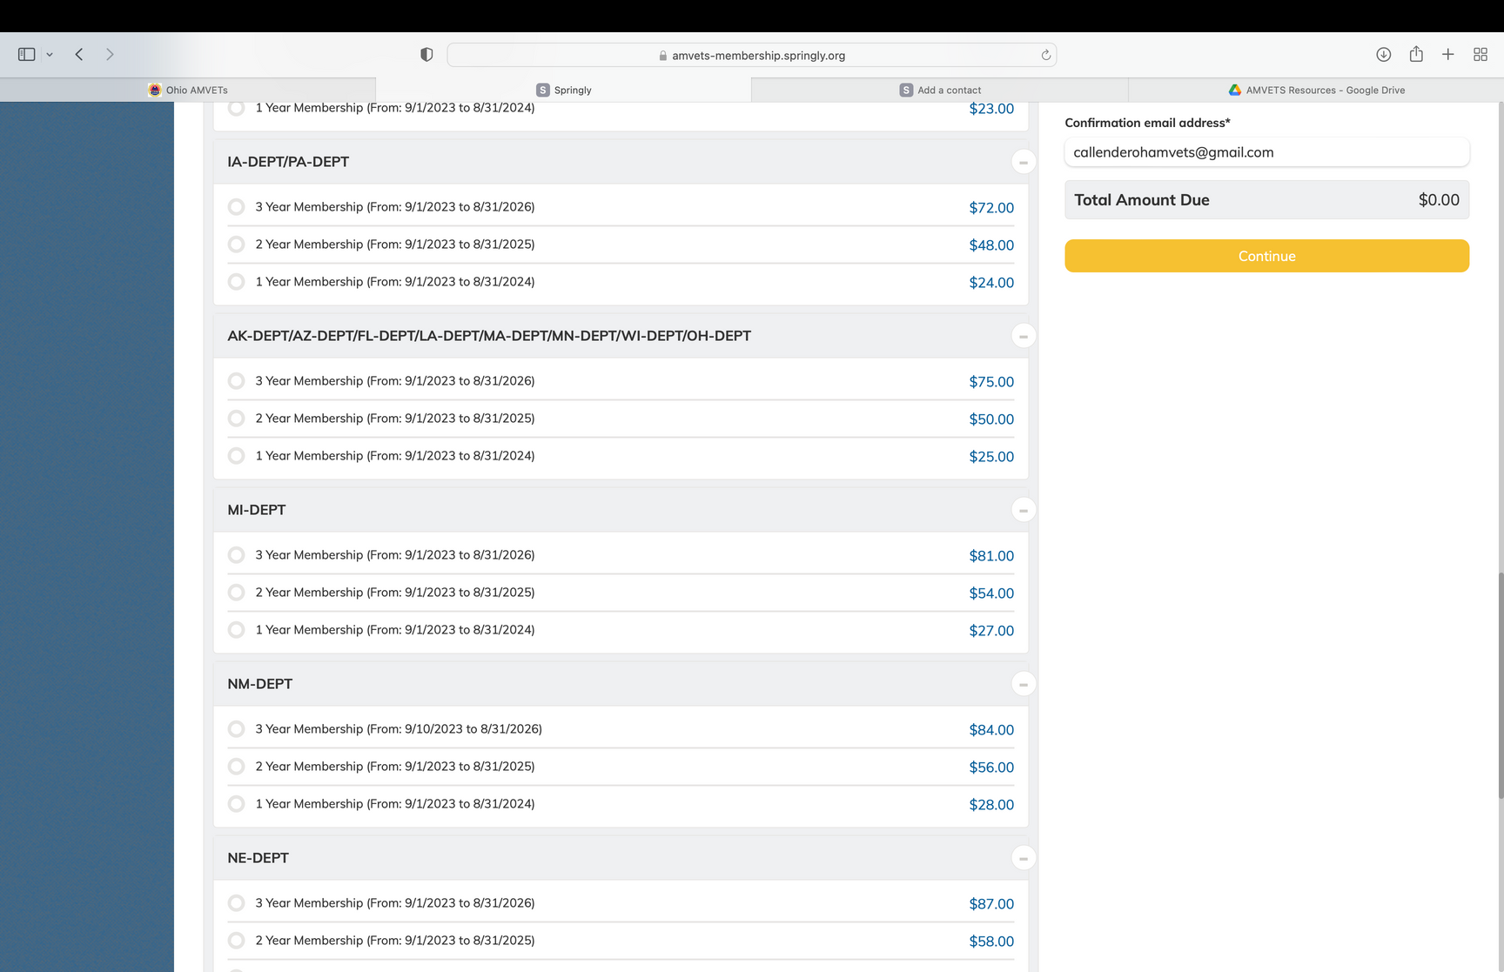
STEP 6
If you are paying for an annual member scroll down to find the “OH-DEPT”

Slide 8
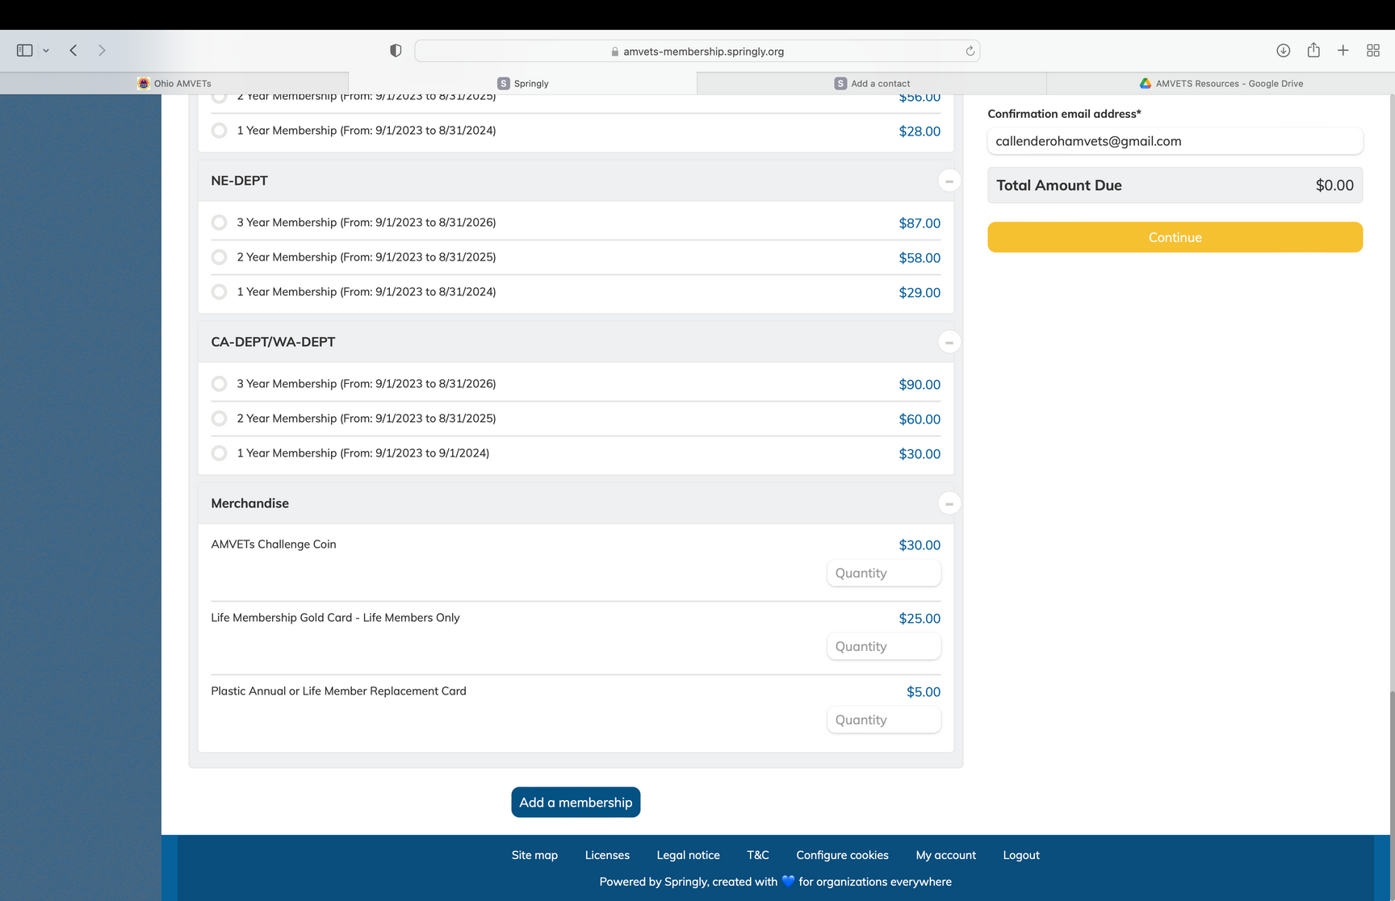
STEP 7
If you are renewing more than one person, scroll to the bottom of the screen and select “Add a membership” then repeat steps 5+6

Slide 9
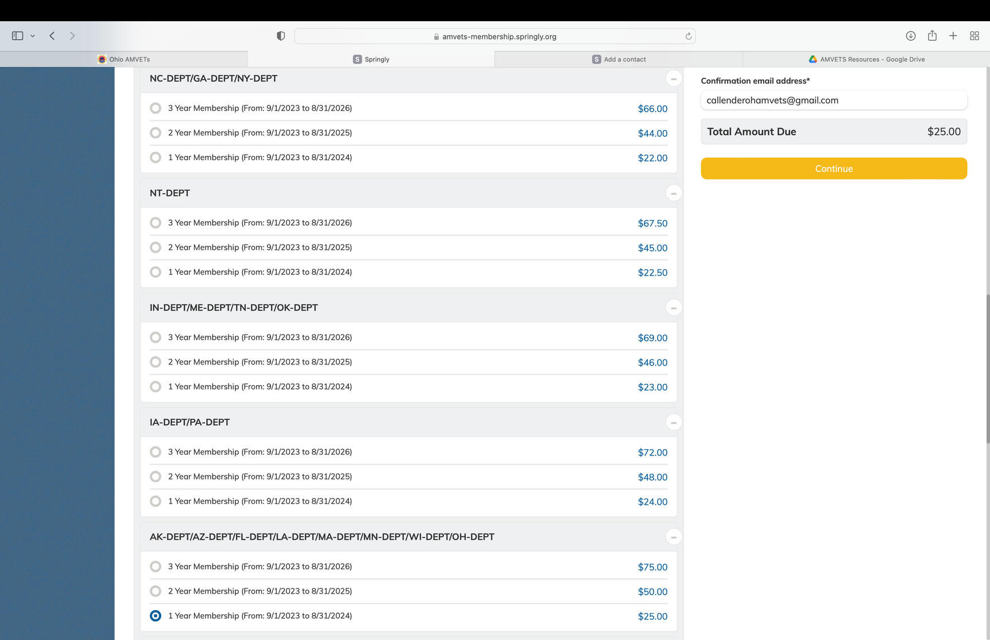
STEP 8
Once all members are added and you are ready to pay, select “continue” on the top right side of the screen

Slide 10
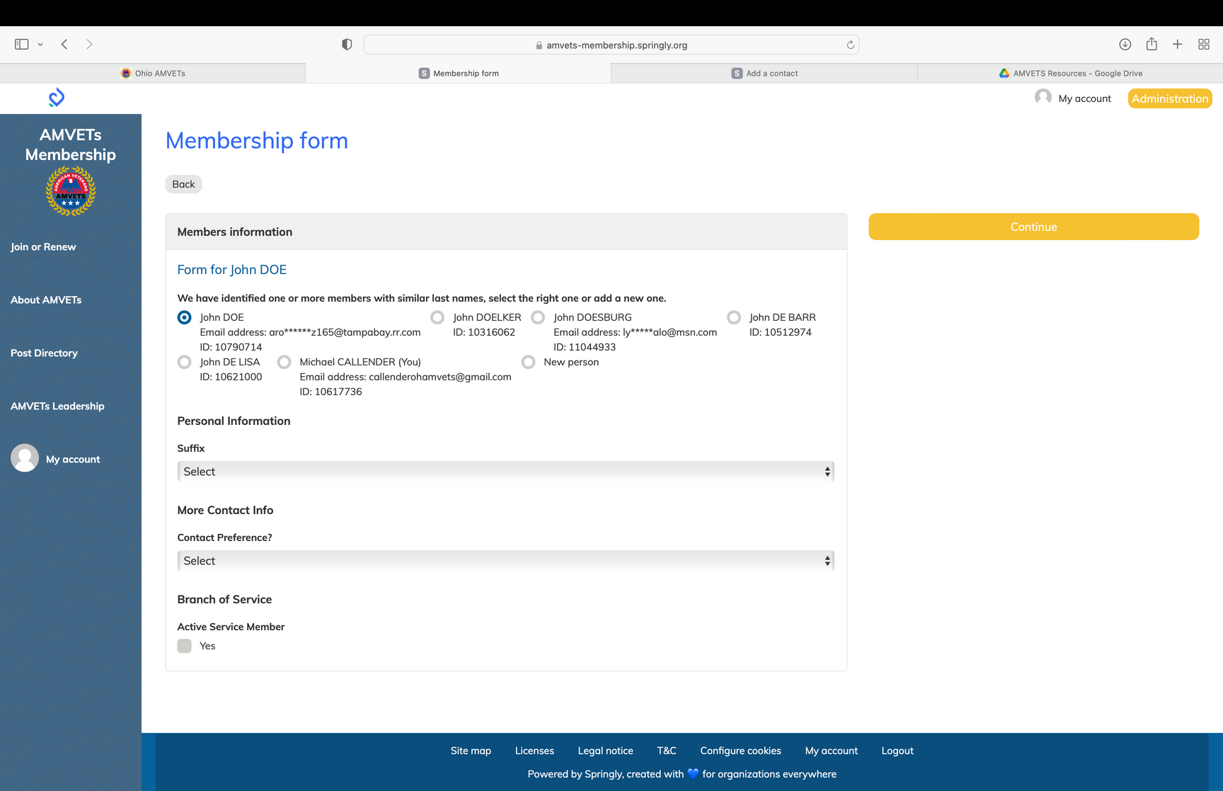
STEP 9
If there are multiple members listed under the same name, confirm the correct member by their email address and then select “continue” on the right hand side of the screen

Slide 11
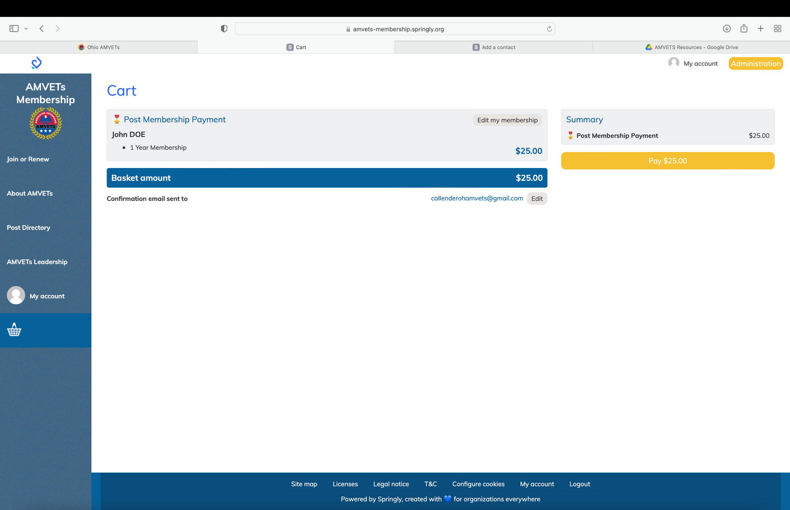
STEP 10
Select “pay” on the top right side of the screen

Slide 12
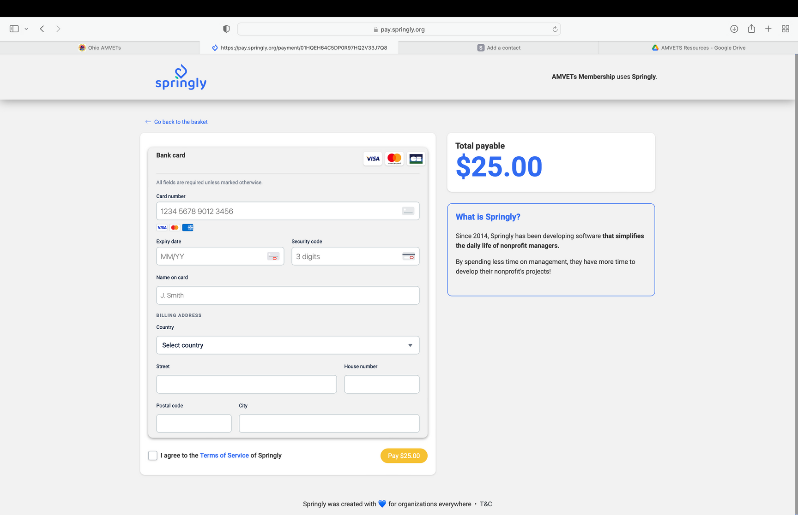
STEP 11
Enter credit card information and complete payment

Slide 13
Congratulations!
You have completed Membership Renewal + Payment

