Slide 1
National Programs
Online Reporting

Slide 2
Mission Statements
AMVETS Mission
To enhance and safeguard the entitlements for all American Veterans who have served honorably and to improve the quality of life for them, their families, and the communities where they live through leadership, advocacy and services.
AMVETS National Programs Department Mission
To provide department and post level support that will culminate in vibrant and effective programs serving veterans and this nation’s citizens.
Notes:
What are the Changes?? Or should we take this out

Slide 3
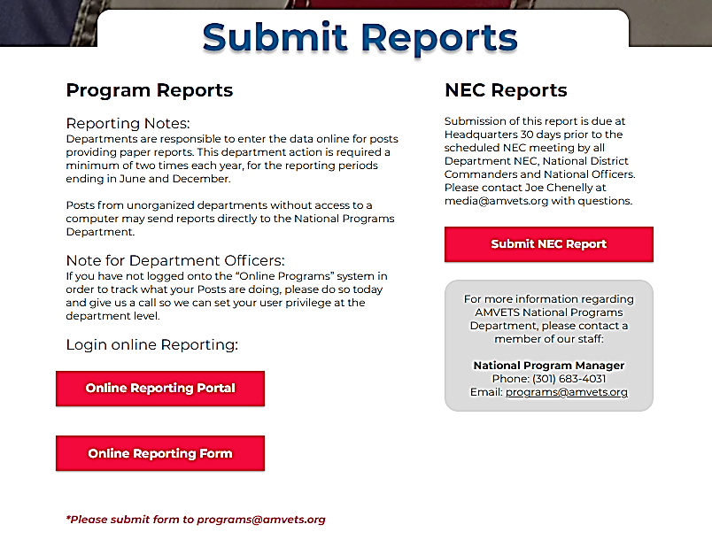
Online reporting account set up
Visit https://www.amvets.org/submit-reports

Slide 4
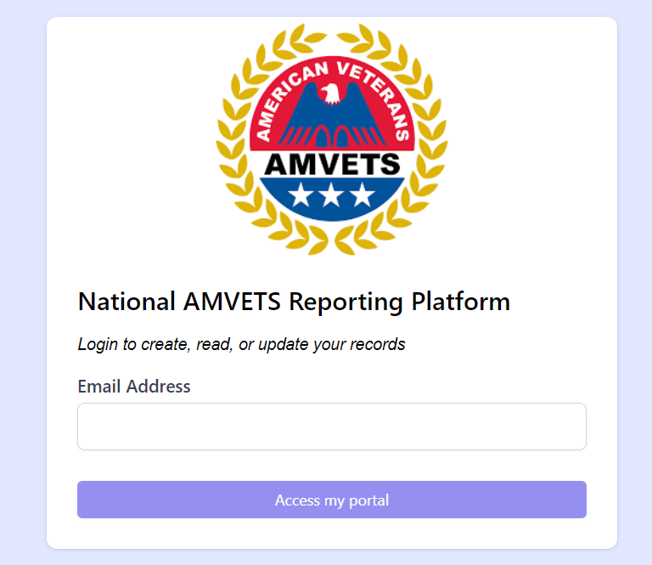
Type in your email address

Slide 5
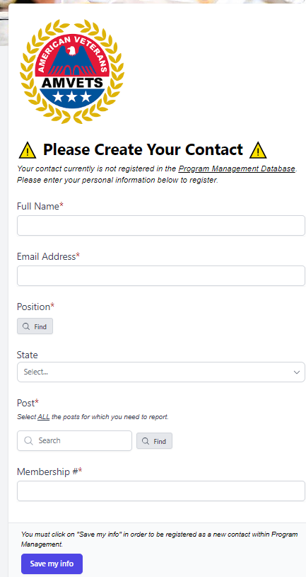
Complete the application

Slide 6
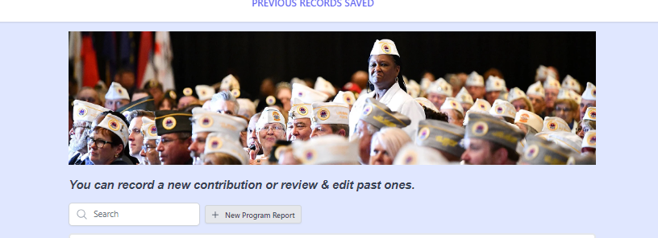
Click on “+ new Program Report”

Slide 7
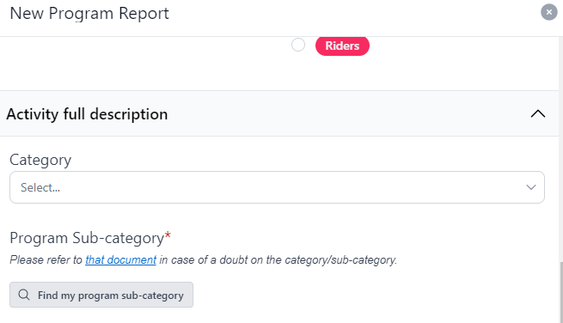
AMVETS Programs Categories (subcategory) a`
https://pdfhost.io/v/Yea5gBYCJ_Microsoft_Word]_2023_Reporting_categories
Click “that document” to access the categories list

Slide 8
Reporting Values
National Values
National District Values
Department (statewide) Values
Post (Local) Values

Slide 9
National Programs Team
Commander, Donald McLean
Executive Director, Joe Chenelley
National 2nd Vice, Paul Shipley
Programs Director, Carol Hebert
Programs Manager, Colondra Etheredge
Thank you for all you do for our veterans!

Slide 10
QUESTIONS
Email programs@amvets.org
or
call Carol 301-683-4027 or Colondra 301-683-4031

