Slide 1
Amvets Dept. of Ohio
Post Officer & Trustee Disciplinary Training
2018
Canteen Violations
Presented by
Dept. of Ohio Judge Advocate

Slide 2
Pre - introduction
The discipline process of the Amvets is one of the most misunderstood, disregarded or ignored sections of the of the CBL’s.
Many post trustees / officers fail to realize the importance of the disciplinary process.
When done improperly it can cause morale problems in the entire post.
It also decreases the respect and confidence the membership has in its officers and or trustees.

Slide 3
Introduction
Being a post Officer or Trustee is one of the hardest if not the hardest job in the AMVETS Organization.
Post members look to you for answers to their post questions and problems. They expect their Officers & Trustee’s to be fair, just and knowledgeable in AMVET policies and procedures.
As Officers & Trustees you owe it to your post and to yourself to study the State and National CBL’s.
But especially study the Dept. Uniform Post Constitution and bylaws. (UPCBL).
Notes:
Study UPCBL & NCBL (appendix B)

Slide 4
Introduction.
Post Board of Trustee’s not only have the responsibility of overseeing the day to day operation of the Canteen but they also have the difficult responsibility of maintaining order and decorum in the Canteen.
It is the responsibility of the members of the BOT to be the peacekeepers and peacemakers of the canteen.
Always Remember
“The Best Discipline Hearing is the one that was avoided”
“Try to talk the problem out before resulting to Charges & hearing’s”
“If all else Fails be fair and consistent in the trial process…….”

Slide 5
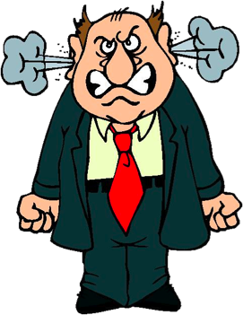
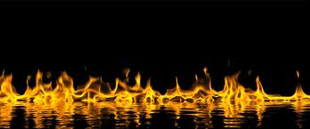
Introduction..
Because!!!!
Nothing Angers a member more than when he or she is not treated justly and by the book, or see’s that the rules are not enforced fairly or consistently.
This will drive members away from your post faster than anything else.
“ That wasn’t fair, I'm outta Here!”

Slide 6
Canteen discipline
Canteen Violations

Slide 7
What we will cover (Overview)
National CBL (constitution & bylaws)
Dept. of Ohio CBL
UPCBL (uniform post constitution & bylaws)
Canteen/Club room Violation , Charges & 3 member disciplinary hearing.

Slide 8
(Authority) National & Department CBL
NCBL Article VII Section 3(b)
Wherever a post clubroom is maintained and operated for the convenience and pleasure of its members and the name of AMVETS or its insignia is displayed or used, a board of at least three trustees shall be elected by and from among the members of the post to supervise its activities, operation and finances.

Slide 9
National & Department CBL.
Dept. of Ohio CBL
Article XX Section 1
Each Post of the American Veteran, AMVETS Department of Ohio shall be the Judge of its own membership, subject to the restrictions of the Uniform Post Constitution and bylaws…
UPCBL (Uniform Post Constitution & Bylaws)
The discipline of post members shall be as provided in the National bylaws, Article V and the Uniform Code of Procedure for the Suspension or Expulsion of a Member (appendix B).

Slide 10
Canteen/Clubroom Rules.
UPCBL Article XXI Section 7
House Rules Shall be drafted by the board of trustees and are to be posted in a conspicuous place in the Post club room/Canteen.
(That does not mean they are posted in the meeting room)
UPCBL Article XXII Section 1
The Posted rules and Regulations in the club room, approved by the Board of Trustees, apply to all members of AMVETS , AMVET supporting members and guests.
This Means Everyone…..

Slide 11
What is a Canteen Violation
A canteen violation is an infraction of any POSTED club rule(s) as set forth by the Posts Board of Trustees.
If it’s not posted its not a canteen rule!
No Rule should be considered common knowledge
“How Can you Charge someone with an Offense
if they don’t know the rules”!
Notes:
Example: The post that charged a member with not registering her guest into the post. She had no Idea she had to, as it was not part of the posted rules. The Commander thought it was common knowledge. Charges dismissed!

Slide 12
Who can file a canteen violation!
UPCBL Article XXII Section 2 (page 19)
Any member may prefer charges against any other member for violation of club rules and/or regulations and charges shall be made in a format as suggested by the Board of Trustees. The charges shall set forth, as near as possible, the date, time and the basis for all charges.
Notes:
Subordinate members file a letter of Complaint. But the Charges must be signed by a Veteran

Slide 13
Canteen Violation form
Notes:
This form should be standard write-up form at all posts.

Slide 14
UPCBL Article XXII Section 2
All Canteen Violations shall be filed with the Board of Trustees.
Canteen Violations shall be heard by a 3-person disciplinary panel established by the Board of Trustees.
The Board of Trustees should at their first meeting following post elections establish a three person panel to hear charges as may be filed by members for infractions of club rules and regulations.
Notes:
Changing Panel members every 3 or 4 months Gets more members involved in post processes ( membership participation ) Get the members involved! If you have not assigned a 3 member panel you should get it done ASAP

Slide 15
Who Makes up the 3 member Panel?
The panel is made up of three members chosen and assigned by the BOT (Board of Trustees) to hear Canteen Violations.
Members of the panel are Veteran Post members in good standing with the post and of good character.
The Panel is not to be officers or BOT members.
The panel serves a 1 year term or a term decided by the BOT.
Notes:
Changing Panel members every 3 or 4 months Gets more members involved in post processes ( membership participation )

Slide 16
UPCBL Article XXII Section 2 Cont..
No member against whom charges have been preferred, or who has preferred charges against, shall sit in judgment on any board, committee, or panel deciding the issue.
Notes:
If you are charged with an offense or if you have charged another person with an offense you can not sit in Judgement on those charges.

Slide 17
UPCBL Article XXII Section 2 Cont…
Members may be suspended from the use of the post club room by action of the Board of Trustees.
The Board of Trustees can suspend club room privileges by concurring with the three member panels recommendation for punishment. Or through its own decision. (Appeal)
Notes:
The decision of the 3 member panel is binding only after their disposition has been approved by the board of trustees.

Slide 18
UPCBL Article XXII Section 2 Cont….
Any member under suspension of club room privileges shall not be permitted in the club room until termination of the suspension.
However, a member that is serving a suspension of club room privileges shall be permitted to attend post meetings, but said member must vacate the premises upon completion of the meeting.
The suspended member may also participate in any and all AMVET functions. (not held in the Canteen)
The Board of Trustees cannot suspend AMVET or Post membership.
Notes:
Only the Post Executive Board can suspend Post membership privileges.

Slide 19
UPCBL Article XXII Section 2 Cont…..
A member who has been suspended from club room privileges may appeal the suspension to the Board of Trustees within 15 days in writing. The member may then present their case to the Board of Trustees for consideration.
It is a basic premise of law, That every one has a right to an appeal, so is the case with AMVETS.
The appeal process to the Board of Trustees is final and binding if the filing and hearing was properly held.
Notes:
Remember! Canteen Violations Start and finish at the post level.

Slide 20
UPCBL Article XXII Section 2 Cont……
New June 2018
Notification by the Board of Trustees to the member, to whom charges have been preferred against, shall be by certified mail within 5 days of receipt of charges.
The member has rights. (including subordinate members)
The member must also be notified in the same manner for the appellate hearing if one is requested.
The member has the right to be present at all hearings and to present evidence in his/her own defense.
Notes:
It is a basic premise of American law, That every one has a right to an appeal, so is the case with AMVETS.

Slide 21
Sample Notification letter
Dear Mr. ----
You are hereby cited to appear for a hearing at AMVETS Post __ before a 3 member panel at 8:00p.m. on Wednesday November 15, 201_, to show cause why you should not be suspended from the canteen on the following charges:
[Text or copy of charges and specifications]
By order of the Board of Trustees, adopted at its meeting on October 14, 201_
Joey E. Brown,
Chairman
Post __ Board of Trustees
(Copy of Charges must accompany Notification letter)
Notes:
This is a basic letter

Slide 22
UPCBL Article XXII Section 2 Cont…….
Guests of members violating the rules and regulations of the post shall be automatically suspended, and the member held responsible.
Members are responsible for their guest.
If a guest disobeys the rules the member should escort the guest from the premises.
Notes:
Guests can be instantly suspended and removed. Members cannot be instantly suspended and must be given a proper hearing.

Slide 23
UPCBL Article XXII Section 3 (new June 2018)
Members of a subordinate organization may file a letter of complaint with the chairman of the board of trustees who shall investigate and take appropriate actions as provided for the constitution and bylaws. . If the letter of complaint by a subordinate member is against a Veteran and the complaint is not already cosigned by a Veteran member, The Board of Trustees after completing their investigation deems the incident worthy of adjudication by a majority vote, shall direct the post Judge Advocate to cosign the letter of complaint previously signed by the subordinate member.

Slide 24
Summary
NCBL allows that each post shall be the judge of its own membership.
Any member may file charges on any other member.
A canteen violation is an infraction of any POSTED canteen rules. As established by the BOT
All Canteen violations are filed with the BOT.
Members are notified of charges by certified mail. (with Copy of Charges attached)
All members (including subordinate members) have the right to a hearing and to defend themselves they also have the right to an appeal.

Slide 25
Summary
All Canteen violations are heard before a 3 member panel.
The BOT only hears the case on appeal & their decision is final.
Members canteen privileges can be suspended only through the action of the BOT.
The BOT may suspend club room privileges but cannot suspend membership privileges.
Subordinate Members do not file charges. They file a letter of complaint which opens an investigation by the BOT for possible charges which must be signed by a Veteran witness or the post JA (as directed by the BOT).

Slide 26
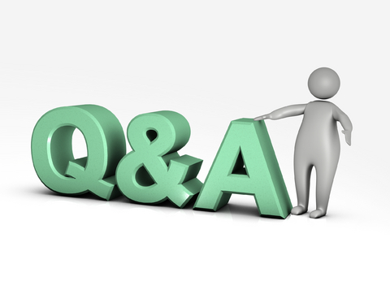

Slide 27
Question?
(Q) What type of violations goes to the post three member disciplinary panel and not directly to the BOT (Board of trustee’s) or the Executive board?

Slide 28
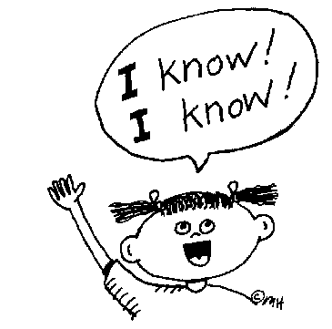
Answer
(A) Any Violation that would constitute a Canteen or Club room Violation.

Slide 29
Question?
Why are Canteen Violations heard by a 3 member panel and not the Board of Trustees?
Good Question!

Slide 30
Answer
Since Canteen Violations are handled at the post level. (from start to finish) allowing the three member panel to hear the charges first, allows the accused member to exercise their right of appeal.
The Board of Trustees is the appellate Board and their decision is final.

Slide 31
Question?
Do Social Members (Commanders guest list members) have any right to a hearing for a canteen / club room violation?

Slide 32
Answer!
NO!
A Social member is a Guest and only a guest, They have No rights under the Amvets CBL and are automatically suspended for a violation.
Notes:
No Hearing needs to be held on Guest Violations. They are automatically Suspended.

Slide 33
Question?
When is it proper to have a son or an auxiliary member on the 3 member disciplinary panel?

Slide 34
Answer
NEVER
1. AMVETS posts are veterans posts. Over seen by a board of Veterans and elected by Veterans.
2. Sons and Aux. Should never be allowed to sit in judgement of a Veteran.

Slide 35
Question?
How is the accused notified that charges have been filed against them?

Slide 36
Answer!
A Notification letter sent by Certified Mail.
Notes:
Letter must be sent within 5 days after the Chairman of the BOT receives the complaint.

Slide 37
Question?
Can a Veteran write up a canteen violation on a Son or Auxiliary member?

Slide 38
Answer!
Yes, if a member witnesses a subordinate member violating canteen rules. The subordinate member can be written up in the usual manner, sending the completed complaint form to the BOT for review and proper adjudication by the 3 member panel.

Slide 39
Question?
Can a Son or Auxiliary member write up Canteen Violation charges on a Veteran?
Hmmmmm!
(insert “Jeopardy” song)

Slide 40
Answer!
NO!
A subordinate cannot file charges directly on a Veteran
A canteen Violation would be written up as usual in the form of a letter of complaint and sent to the BOT for consideration and possible charges.
Those charges must be filed and signed
by a Veteran witness or by the post JA (as directed
by the BOT).

Slide 41
Question
Can a member or Subordinate member be suspended or banned from the Canteen without a hearing?

Slide 42
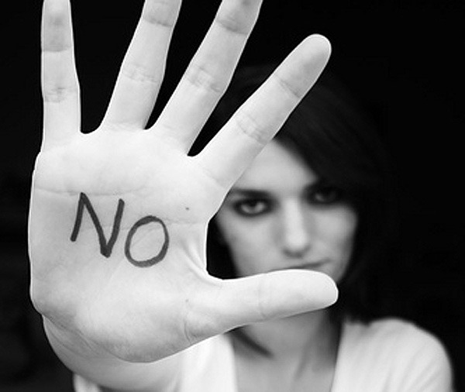
Answer!
NO!
Members of any of the recognized AMVETS Organization cannot be suspended or banned from the canteen without a proper hearing!
To do otherwise,
The officer(s) and or Trustee(s) or Manager involved may be subject to charges themselves. (conduct unbecoming)
Only a guest can be suspended without a hearing!
HAVE A FARE AND PROPER HEARING!
Notes:
Officers, Trustees & Canteen Managers - DO NOT SUSPEND or BAN members or subordinate members without a proper hearing or you can have Charges filed against you. However you can automatically suspend a guest that has violated the posted rules.

Slide 43
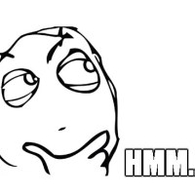
Question
Can a Canteen Manager suspend anyone from the Canteen?

Slide 44
Answer
No
Only the board of trustees can issue a canteen suspension and only after proper hearings.

Slide 45
Question ( Sons & Aux.)
Does the BOT have to honor discipline handed out by subordinate organizations to its own members if it involves a canteen suspension?

Slide 46
Answer
It depends on how the subordinate organization writes the disposition of the punishment it hands out.
If the subordinate organization states in its disposition that they are giving its member a canteen suspension. That wording would not be correct and need not be accepted by the BOT (As only the BOT can issue a canteen suspension)
If a subordinate organization wishes to include a canteen suspension in its disposition they must state in their disposition that they are suspending the membership privileges of the offending subordinate member. They must also state that the subordinate member is NOT in good standing with the subordinate organization during the term of the suspension.
If worded in this manner, the post BOT MUST keep the offending subordinate member out of the Canteen until the subordinate organization places the member back in good standing or the suspension period ends.
This is required by State Law as part of the posts liquor license.

Slide 47
Question?
Who has the ultimate short term removal authority in the Canteen?
Post Judge Advocate ?
Commander?
Chairman of The BOT?
Provost Marshal ?
Bartender?

Slide 48
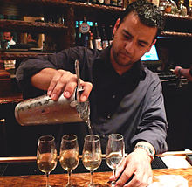
Answer!
The Bartender, they can remove anyone from the Canteen at anytime (including Officers & Trustees) .
Notes:
This is permitted by State Law

Slide 49
QUESTIONS?
Contact your District Commander or District Judge Advocate!
If they can not assist you they will direct you to call the Department JA.
Remember the (Chain of Command)

