Slide 1


Ohio Veterans Homes (OVH)
State Veteran Homes nuts and bolts: SVHs are state owned and operated by the Ohio Department of Veterans Services (ODVS); the ODVS director is on the Governor's cabinet. The SVH program is a federal-state partnership whereby the VA (VHA) provides assistance: grants to construct, per diem payments per Veteran for care, and funding to support states for hiring and retaining nurses.
State Veterans Homes provide many advantages to Veteran care, health and morale. It starts with the camaraderie that Veterans felt when they were still serving their nation, an endeavor that for many included significant time away from family, exposure to harsh environments and injury or loss of fellow service-members and friends…
Notes:
How many of you are aware of SVH in Ohio… visited?
How many of us have had to assist parents or family members try to make this leap to asst living or nursing care… was it easy, did you loved ones just fall in love with each place that you visited… envisioning all the friends they would make, the great food the commonality they were sure to have with everyone that lived there?
Follow slide bullets
SVH should be an option for Veterans as they age or their need for nursing care grows – and for most of Ohio it is not.

Slide 2

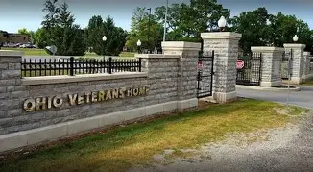


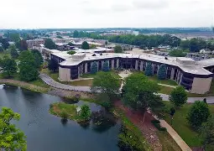
Why we need additional OVH
Ohio has almost 700,000 Veterans – 8th largest state Veteran population; however, There are no SVHs within significant Veteran populations…
Ohio currently has two State Veteran homes in operation. One located in the northern part of the State in Sandusky and the other located in the southern part of the State in Georgetown, Ohio.
Ohio needs additional State Veterans Home (SVH) capacity for Veterans requiring skilled nursing care and domiciliary residence in Ohio. Out of the 173 SVHs nationally, Ohio only has 2 homes…
Notes:
Follow bullets

Slide 3
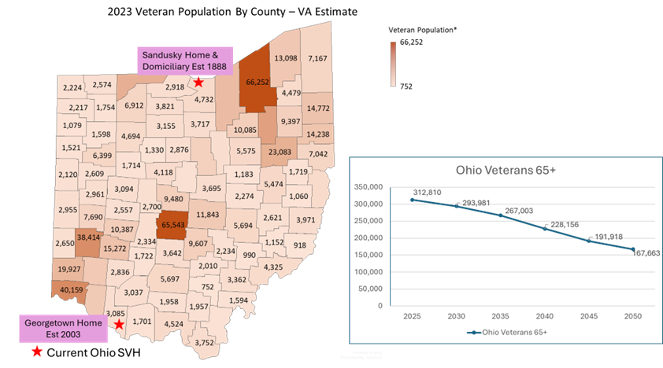
Ohio Vet Pop. Focus on over >65
According to the 2023 VA Veteran population projections, the veteran population ages 65+ in Ohio will be approximately 309,489 in 2026
Ohio remains underserved and the need for beds will not diminish.
Based on the 2020 study by the VA, the State of Ohio should have 2,143 beds.
Currently Ohio has 595 nursing home beds between the two facilities, however, not all beds are available.
…and look at where the homes are
located in comparison to where Veterans live!
Notes:
Follow bullets
Might add: In my last visit to Sandusky, I met a couple of Veterans who were in their 40’s – these homes can serve all veterans who have significant need requirements regardless of their age.

Slide 4

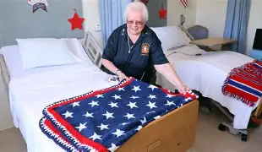
Ohio’s Bed Authorization
Ohio Veterans Home – current occupancy (Nov 2025) in RED
• NURSING BED CAPACITY:
  Sandusky Nursing Home: Tot: 427 (240)
    Standard Nursing Care: 319
    Alzheimer’s Care: 108
  Georgetown: Tot: 168 (105)
    Standard Nursing Care: 168
  Total Nursing Care Beds: State Tot: 595 (345) @ 42% Vacancy
    VA Authorized
    Maximum Beds Allowed by (38 CFR 59.40): 2,143
    Ohio’s Unmet Standard Nursing Home Beds: 1,548
    DOMICILARY BEDS (Sandusky) 206 (113) @ 45% Vacancy
Ohio has only 28% of it’s authorized beds
Notes:
Start with bold capacity, Green box build, disc current occupancy
Disc VA Authorization and add orange build
Disc Dom

Slide 5
How are additional OVH funded
The VA State Veterans Home Construction Grant Program is a partnership between the U.S. Department of Veterans Affairs (VA) and the States to construct, renovate or repair State owned and operated nursing homes, domiciliary and/or adult day health care facilities.
VA program staff review and approve initial grant applications from states for listing on the annual VA Priority List, which the VA Secretary then approves.
SVH construction is generally funded ~65% federal and ~35% state dollars
A new 120 bed SVH costs ~ 130 million to plan, construct & equip!
SVH Operating costs are generally shared at a 40 / 40 / 20 split - federal / state / Veteran paid dollars
Urgency – if the state leadership acted today, there are already over 80 validated nationwide construction projects waiting on federal funds at just under 1.3 billion dollars. On average the VA allocates around 170 million annually: a new Ohio Veteran Home (OVH) would be 8-10 years from receiving the matching 65% federal funding!
Notes:
Follow slide
Urgency slide build
Background Note: The program is authorized in Title 38 United States Code (USC) Section 8131-8137 and regulated in Title 38 Code of Federal Regulation (CFR) Part 59. VA may participate in up to 65 percent of the cost of construction or acquisition of State nursing homes or domiciliary or for renovations/repairs to existing State Homes.

Slide 6
Where we are & who is eligible
Ohio currently has only 28% of nursing home bed capacity based on VA need projection.
State Veteran homes provide a level of services and camaraderie to the veteran community that meets the special circumstances of military service
ELIGIBILITY FOR VETERANS:
Any veteran who has served in the Armed Forces of the United States during armed conflict who was discharged under honorable conditions and is a resident of the State of Ohio one year and who because of age, injury or disability, is unable to provide support for himself and his family is eligible for admission. DO WE HAVE IT RIGHT?

Slide 7
What is the plan for current OVH
Apr 2024:
Ohio FY 24/25 budget included $65 million to improve and modernize existing facilities in Sandusky and Georgetown
Applied for $120 matching grant form VA
Conversion to Single occupancy rooms
HVAC, Plumbing upgrades
Georgetown; extension of building
Sandusky; new building and modernization
Bed count will stay the same
Oct 2024: OVH Modernization Project
VA released FY 2024 VA State Home Construction Grant Priority List; at this point Ohio is likely 3-6 years from Federal matching funds to start modernization to our two existing homes
Two projects which state received matching grants for in last years
Currently…
On-hold for reevaluation (ODVS is taking a second look at modernization approach)

Slide 8
What we’ve done and need to do
2022:
ODVS Advisory Committee; was made aware, and every meeting since has been discussed
Advised veterans organizations to send letter and make a priority
Letters sent form OSACVSO/OSACVSC to governors' office
2023:
State agendas silent
2024:
Informed Advisory Committee that they needed to push this through their organizations
State agendas silent
2025:
…and the same in 2025
Briefed the Veterans Caucus & Senator Terry Johnson; Omnibus Bill; required ODVS to conduct study on OVHs and submit by Sep 2026 – This is one of our opportunities!!
So here we are
We need to tell our state legislators that Ohio is better than this
Challenges:
Sandusky has empty beds
Lobbyist advocate for private nursing homes
Legislators have other priorities, even though they love veterans
Bottom line: we need to tell them Ohio is better than this and we need newer veterans' home throughout the State of Ohio!

Slide 9


What you need to do…
Use the QR code to the right to stay up to date on information. We will share talking papers in the future
…and your organizations to tell our legislature in a very loud voice that Ohio is better than this.
Building New Veterans Homes for
Ohio’s VETERANS must start Now!

Slide 10
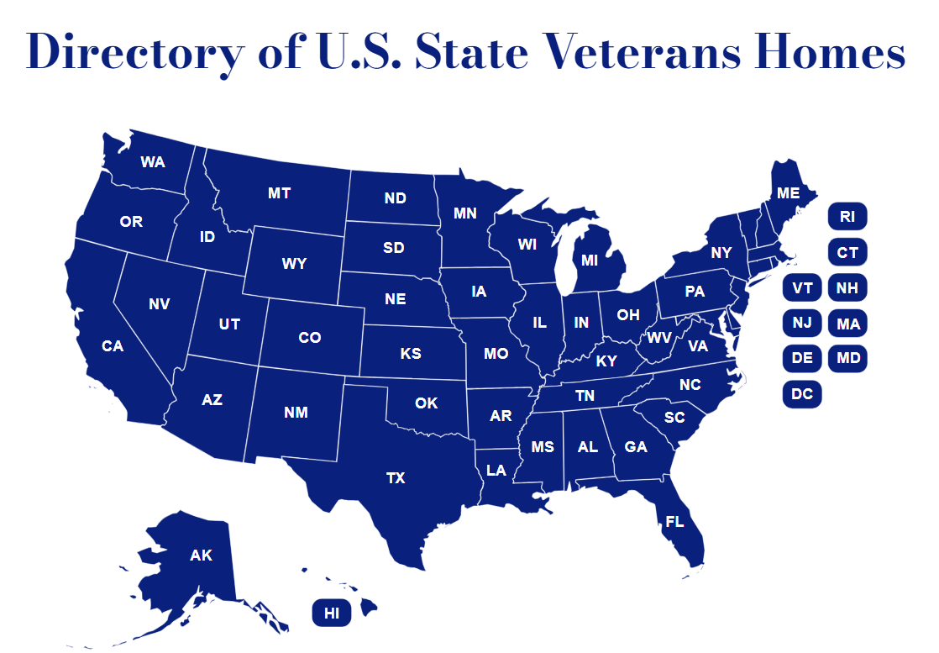
Other States
https://nasvh.org/directory/

Slide 11
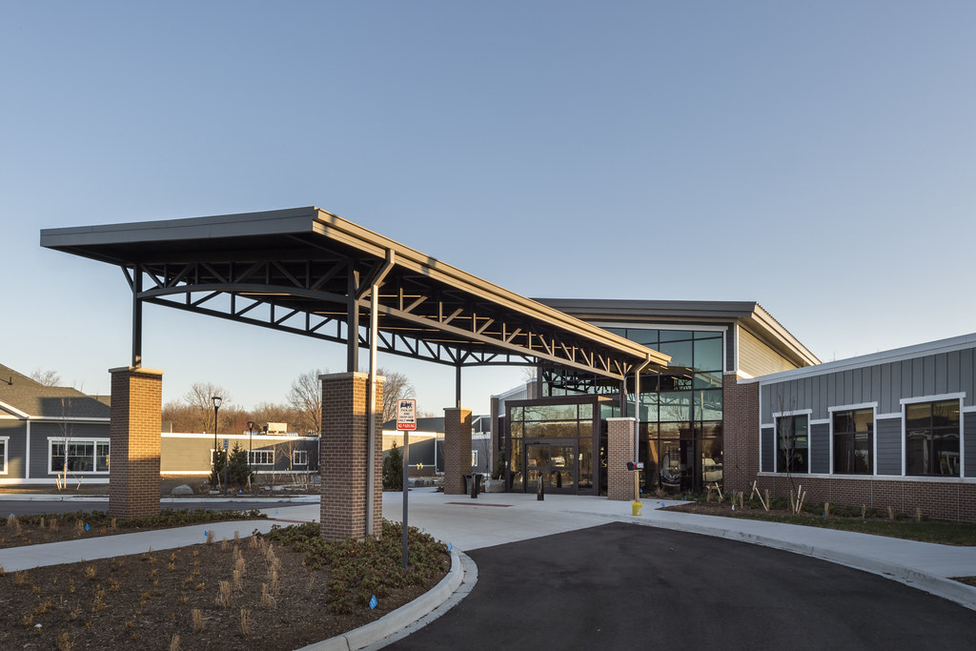
Isn’t this SVH Amazing?

Slide 12
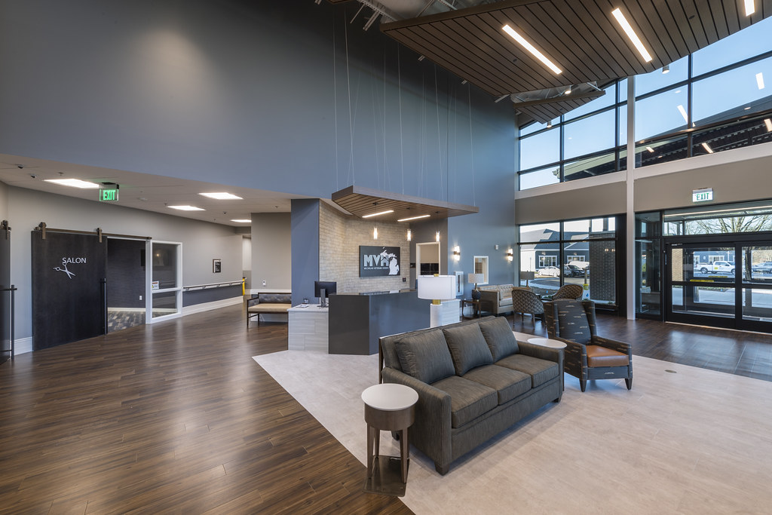

Slide 13
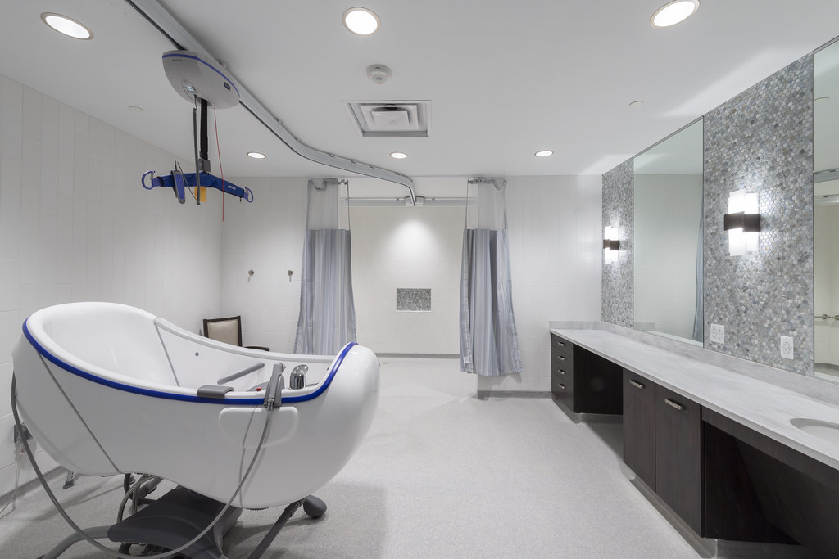

Slide 14
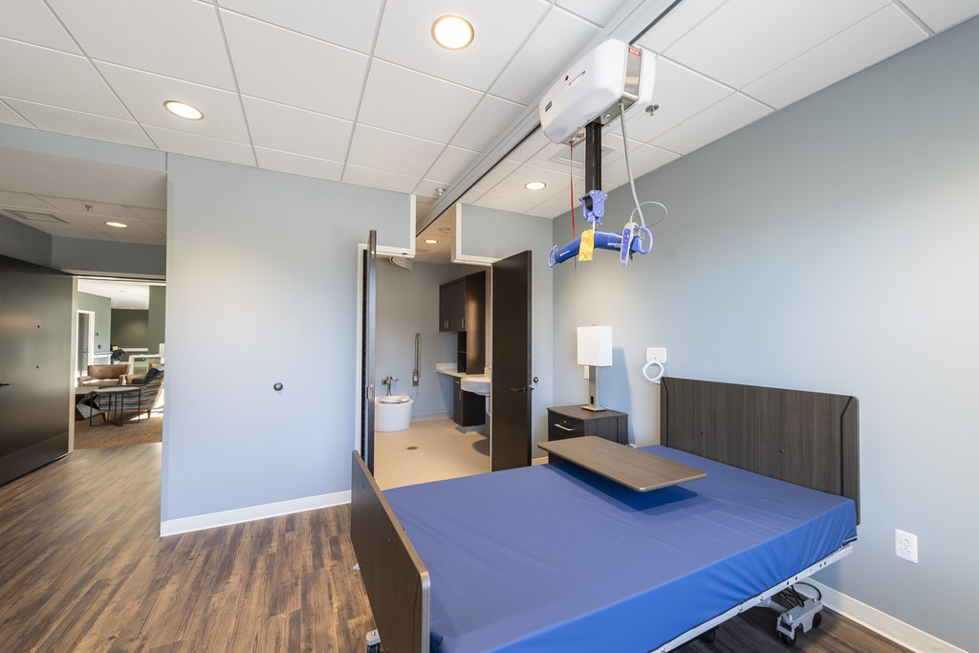

Slide 15

This Veteran home is in
“the state up North”
Michigan!

