Slide 1
Dept. of Ohio Disciplinary Training Part I - II

Slide 2
Part I – Post Violations Part II - Canteen Violations

Slide 3
Post Discipline Introduction to part I & II
The post disciplinary process is one of the most misunderstood or ignored aspects of running a post.
Many post trustees / officers fail to realize the importance of a proper disciplinary process.

Slide 4
Why is it important ?
Most members know they have rights in the organization and that there is a disciplinary process that needs to be followed.
And they will rightfully call foul if it is not followed correctly or not done at all. Causing the
District / Department to step in on the members behalf.

Slide 5
It can also Cause
morale problems in the post.
and can decrease the confidence and respect the membership have in their officers and trustees.

Slide 6
Every post officer and trustee, by accepting the responsibility their position:
Owes it to the membership and themselves to study & learn this process.
And to treat every member the same, no matter who they are, what position they may or may not hold or the offense they are accused of…Because!!!!

Slide 7
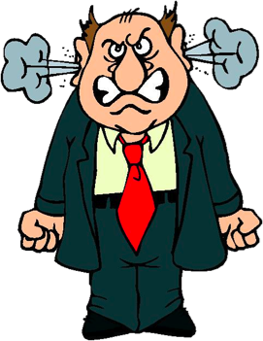
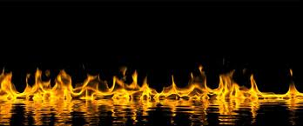
Nothing Angers a member more than when he or she is not treated justly and by the book, or see’s that the rules are not enforced fairly or consistently.
This will drive members away from your post faster than anything else.
“ That wasn’t fair, I'm Outta Here!”

Slide 8
5 things every officer and trustee should know.
1.
A member cannot be given a post or Canteen suspension without a proper hearing.
The only exception to this would be if there is reason to believe that letting the violator back in the post before their hearing date could cause physical harm to persons or property of the post.

Slide 9
2.
The difference between a Canteen Violation and a Post Violation.
Simply a canteen violation is a violation of any posted Canteen rule.
If the violation is for anything else it is a post violation.

Slide 10
3.
Who receives and hears (handles) the violation.
a) The Chairman of the board of Trustees receives written canteen violations. The violations are heard by the post 3 member disciplinary panel.
b) The post Commander receives written post violations. The violations are heard by the post Eboard.

Slide 11
4.
Who is the 3 member panel and what is their purpose?
The panel is selected by the BOT at its first meeting after elections. They may hold the position for 1 year or as long as the BOT wishes.
The panel is made up of three post members (should not be officers) that are in good standing and of high morals.
They hear Canteen violations only. (They do not hear post violations) They listen to and read the evidence in the case and make a recommendation for punishment or acquittal to the BOT.

Slide 12
5.
Every Member is entitled by the CBL to know the Identity of there accuser and to have a written copy of the Charges against them!
Continue to Part I or Part II

Slide 13
Part I
Post Violations

Slide 14
CBL’s used
NCBL – Appendix B.
Step by Step guide to suspension or expulsion of a member
Dept. CBL Art. XX
UPCBL Art. XVIII, XX, XXII

Slide 15
Preliminary
Who Receives the charges –
Post Commander
Who Hears the Charges –
Post Executive board
Who Prosecutes the Charges –
Post Judge Advocate
Hearing is held in closed session (executive Session)
NO spectators or Audience

Slide 16
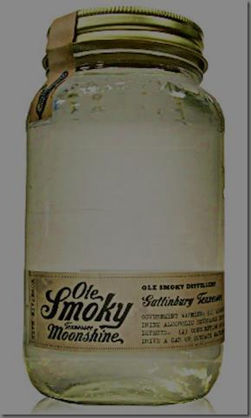
Example violation
Member Smith is a life member and Vice Commander of the post
One evening he takes and unauthorized Jar of Shine into the canteen, which is in violation of the posts standing rules art. 7 and possibly State liquor law and starts pouring shots for his friends and himself.
He is asked to stop by the Bartender and refuses. He is then asked to leave for the evening by the bartender.. He complies.
The next day he is written up by the Canteen Manager and charges are signed by a Trustee.

Slide 17
Is this a Canteen violation or a post Violation?
Post Violation
even though it happened in the canteen.
He violated a post Standing Rule
He was written up on a standard form.
Charges signed by a Trustee.
Who receives the charges?

Slide 18
The Post Commander (Commander Jones)
Receives the charges
He/She checks that the charges have been completed properly and are signed by the complainant.
Commander then signs and dates the complaint form. Thereby officially receiving the charges.

Slide 19
On receipt of the charges and specifications, Commander Jones, within five days sends a copy of the charges by certified mail to member Smith, together with a notice fixing a date, place and time of a hearing to be held not less than 30 days after said date of mailing. Complies w/ NCBL Appendix B sec.3
Key points to remember
Notice must be sent within 5 days of officially accepting and receiving the charges
Copy of the charges are sent with the notice.
Hearing date- No sooner than 30 days of said mailing

Slide 20
Sample Notice
Dear Vice Commander Smith
You are hereby notified to appear before the post Executive board on August 20th 2019 at 1900hrs in the post meeting room. To answer to charges, that you violated Post standing rule article 7. ( No unauthorized Beverages allowed in Canteen)
Respectfully
Commander Jones

Slide 21
Hearing
No member against whom charges have been preferred, or who has preferred charges against, shall sit in judgment on any board, committee, or panel deciding the issue. (NCBL appendix B sec.4)
If the accused is not present at the start of the hearing ( by their own choice) the case will continue to finalization in their absence.
(per Roberts Rules of Order)

Slide 22
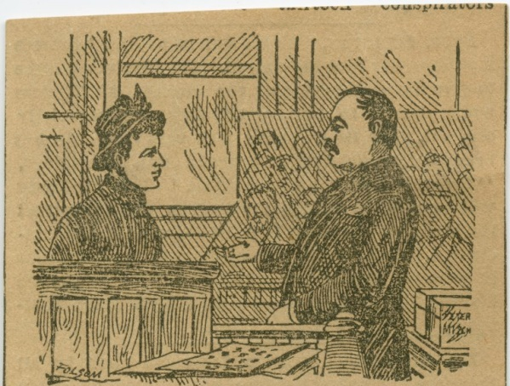
Member Smith has the right to be represented by counsel of his choosing. (Counsel can be an attorney or not (but either must be an AMVET (family member) roberts rules
He also has the right to question and cross-examine his accuser(s) as well as any witnesses for or against him. (NCBL appendix B sec.4)
The presiding officer (Commander Jones) shall decide all questions as to the relevancy of evidence and the regularity of the proceedings.(NCBL appendix B sec.6)

Slide 23
On the conclusion of the hearing, a vote shall be taken first as to whether there is a basis for the charge or charges and, if by the vote, it is determined that there is none, then charges may be dismissed.
If the charges are not dismissed,
then a vote shall be taken on the guilt or innocence of each of the charges and each of the specifications. A two-thirds vote of the members of the executive committee hearing the charges and specifications shall be required to sustain any charge or specification. Voting herein provided for shall be secret or open as said executive committee may, by majority vote thereof, determine (NCBL Appendix B)
Note: The JA after prosecuting the case. Is not part of the deliberations
But should be available for procedural questions only.

Slide 24
Three (3) votes by the board are required at the end of the hearing to sustain a guilty verdict.
(vote1) Majority vote of board is held to determine the basis of the charge(s).
If it is determined that there is no basis the charges are dismissed. If the charges have merit the board moves to vote 2.
(vote 2) A vote to determine guilt. A 2/3rd is taken on each of the charges and specifications

Slide 25
If by a 2/3rd vote a verdict of innocent is reached on ALL charges and specifications, the accused must be found innocent and the charge(s) are dismissed.
If by a 2/3rd vote a verdict of guilty is reached on ANY of the charges or specifications. The member shall be deemed guilty.
The officer presiding at the hearing shall then put the question of the degree of punishment.

Slide 26
(vote 3) Majority vote of board shall determine the punishment that will be issued.
Any member whose membership is suspended or forfeited may appeal to the next highest level applicable from that which heard the charges and specifications
District to State to National.

Slide 27
If guilt is found the member may be called in and given the verdict in person. If not a certified letter must be sent to the member. Either way a certified letter is sent.
They should also be told about the appeal process.

Slide 28
Addendum (October 2019)
If a post for any reason sufficient to the Dept. Comm. Dept JA & the Dept. IG cannot hear a post violation the Dept. Commander thru the Dept. JA or the IG can assign the case to the district Executive board from which the original complaint originated. (refer to UPCBL Art. XX Sec.2 & 3 for details).

Slide 29
QUESTION?
After the Hearing- Is the Executive board allowed to discuss the case with other post members? –
NO!! Proceedings as in any meeting that is held in executive session are confidential. Only the final result (verdict) may be released as needed. Discussing case details opens the post to a libel suit. (Roberts Rules of Order)

Slide 30
Things to Remember
Post Adjutant should keep all minutes or recording and documents locked up securely. In case of appeal.
Keep any and all references pertaining to the case out of social media.
All charges other than canteen violations against a subordinate member must be turned over to the organization the accused is a member of for adjudication.

Slide 31
The post Veteran Eboard cannot put a member of a subordinate organization on a post suspension.. Or any member on a canteen suspension.
If a verifiable and documented violation occurred and the subordinate organization refuses to discipline its member please contact the Department JA.

Slide 32
Can a member of a subordinate organization file a charge against a Veteran?
Not directly but they can file a request for charges.

Slide 33
Dept. CBL Art. XX Sec. 3 (June 2018)
Members of a subordinate organization may file letter of complaint against a Veteran with the Post commander. The Commander shall investigate and take appropriate actions as provided for in the constitution and bylaws. If the said letter of complaint is not already cosigned by a Veteran, The Commander and Executive Board after completing their investigation deems the incident worthy of adjudication by a majority vote, shall direct the post Judge Advocate to cosign the letter of complaint previously signed by the subordinate.

Slide 34
If a member from another post comes into your post and commits a violation. Charges are written up and sent to the Commander of the post to which the offender belongs.

Slide 35
Questions

Slide 36
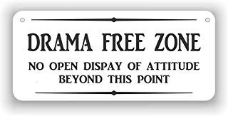
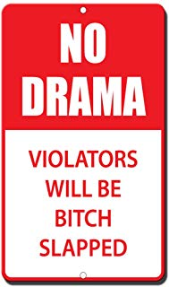
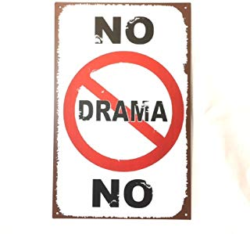
Part II Canteen Violations

Slide 37
What is a Canteen Violation
Simply, a canteen violation is a violation of any posted Canteen rule.
If the violation is for anything else it is a post violation.

Slide 38
Canteen Violation are handled differently than Post Violations
The Initial hearing is held by a selected Panel of 3 post members called the 3 member disciplinary panel.
These Members are chosen by the BOT for their good standing and good values
If done correctly Canteen Violations “Start and Finish” at the Post.
The District, Department and National are not normally involved.

Slide 39
If the BOT is in charge of the Canteen why don’t they hear the charges? (Good Question)
Since Canteen Violations are handled at the post level (from start to finish).
Allowing the three member panel to hear the charges first, permits the accused member to exercise their right of appeal.
The Board of Trustees is the appellate Board and…
Their decision is final.

Slide 40
Procedure
Upon receipt of a written Canteen violation. The Chairman of the BOT checks it for completeness and that it is properly signed by the accuser… Once satisfied.
The Chairman will sign for receipt of the charges.
The Chairman within 5 days will send a notification letter by certified mail to the accused.

Slide 41
The letter must contain the date, time and location of the hearing as well as a copy of the charges.
While no time limit is set in the CBL in regard to how soon a hearing can be held on a canteen violation. It is highly recommended that sufficient time for the post office to deliver the letter be allowed.
The notification letter must be sent by certified mail.

Slide 42
Sample notification letter
Dear Mr. ----
You are hereby cited to appear for a hearing in the AMVETS Post __ meeting room before a 3 member panel at 8:00p.m. on Wednesday November 15, 20__, to show cause why you should not be suspended from the canteen on the following charges:
[Text or copy of charges and specifications]
By order of the Board of Trustees,
Joey E. Brown,
Chairman
Post __ Board of Trustees
(Copy of Charges must accompany Notification letter)

Slide 43
Hearing
No member against whom charges have been preferred, or who has preferred charges against, shall sit in judgment on any board, committee, or panel deciding the issue. (NCBL appendix B sec.4)
If the accused is not present at the start of the hearing the case will continue to finalization in their absence. (per Roberts Rules of Order)

Slide 44
The presiding member of the 3 member panel shall decide all questions as to relevancy of evidence and the regularity of the hearing.
The accused has the right to question and cross-examine his accuser(s) as well as any witnesses for or against the him.
At the conclusion of the hearing a verdict will be reached by the panel by majority vote.

Slide 45
Upon reaching a verdict and deciding on any sanctions the panel will then present their recommendations in writing to the board of Trustees. The board after receiving the recommendation may uphold the panel’s decision or lesson the panels recommended sanctions.
But the board cannot issue a more severe punishment. (Roberts Rules)
The board will then send a copy of its decision to the member by certified mail. Along with information on the appeal process.

Slide 46
Appeal
If the member appeals the decision the process starts over. Starting with the certified letter announcing the time, date and place of the appeal hearing before the entire Board of Trustees in which the chairman of the BOT is the chair.

Slide 47
Appeal
Note that after the appeal hearing the board may render and issue any verdict and sanction the board desires in regard to a canteen suspension and are no longer limited to any decision made by the 3 member panel.
If the appeal hearing was conducted properly the member has no further appeal and the decision of the BOT is final.

Slide 48
Things to remember (canteen violations)
Unlike Post violations the three member panel hears all Canteen violations regardless of who committed the violation or what AMVET organization they belong too. Likewise the BOT hears all appeals pertaining to Canteen violations.

Slide 49
DO not try to bypass any of the steps involved in the disciplinary process. Doing so invites the District or Department to intervene on behalf of the accused.
Putting a member on a suspension without a hearing could result in charges against the officers, trustees or manager involved.

Slide 50
disclaimer
In no way is this guide meant to replace the CBL’s of the National or Department organizations.
Please read the CBL’s before handling a disciplinary case.

Slide 52
Please contact your
District JA or Commander
Or call the Department JA
At 419-306-5350

